Slide 1
Image Classification Based on BOW and SVM
By TA

Slide 2
Image Classification Based on BOW and SVM
Implement the image classification system based on bag of words(BOW) and support vector machine(SVM).
Related Algorithms and source codes (in Matlab) can be found at: http://www.zhizhihu.com/html/y2011/3536.html
Libsvm Download
http://www.csie.ntu.edu.tw/~cjlin/libsvm/
Matlab2014a Install Libsvm
http://blog.csdn.net/loadstar_kun/article/details/7712308

Slide 3
Requirements
Team project:
Less than or equal to four people per team.
Implement the source codes.
Collect images to build the train and test data set.
Optional:
Re-implement in C++ (opencv).
Contact TA for submission.

Slide 4
Report
实验报告内容
组员信息及其贡献
问题分析
源码里面的BOW特征提取详细阐述
SVM详细推导过程
实验结果及其分析
修改源码的：需要在实验报告中说明修改了哪里
C++重现的：代码放在src文件夹，结果放在result文件夹
提交
以’组长姓名+学号.pdf‘方式提交，若有更新，则以’组长姓名+学号1.pdf‘， ’组长姓名+学号 2.pdf‘等方式提交，最后以版本号最大的为准
ftp地址：ftp:/172.18.183.108 用户名：cvpr2014 密码：a207
Submit a report before 06/20.

Slide 5


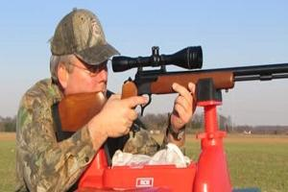
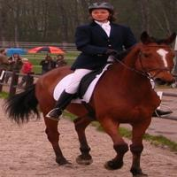

Image Classification System
Training
Training Labels
Training Images
Image Features
Classifier Training
Trained Classifier
Testing
Image Features
Trained Classifier
Prediction
Phoning
Test Image

Slide 6
System Outline
Image Set Collection
Bag of Words Model in Spatial Pyramid
Multi-Classifier Training Using SVM
Multi-Classifier Classifier Prediction Using SVM

Slide 7
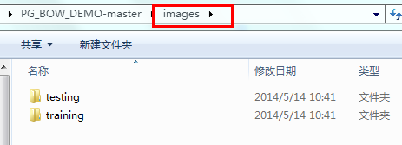
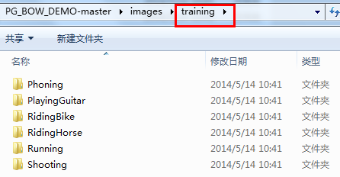
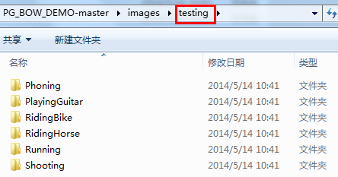
Image Set Collection
源码里面的数据集有6类图像，每一类图像有60张（其中40张训练图像和20张测试图像），且每类图像的大小一致）

Slide 8
Image Set Collection
Fifteen Scene Categories
http://www-cvr.ai.uiuc.edu/ponce_grp/data/
Stanford 40 Actions
http://vision.stanford.edu/Datasets/40actions.html
Caltech-101
http://www.vision.caltech.edu/Image_Datasets/Caltech101/
Graz
http://lear.inrialpes.fr/people/marszalek/data/ig02/

Slide 9
System Outline
Image Set Collection
Bag of Words Model in Spatial Pyramid
Multi-Classifier Training Using SVM
Multi-Classifier Classifier Prediction Using SVM

Slide 10
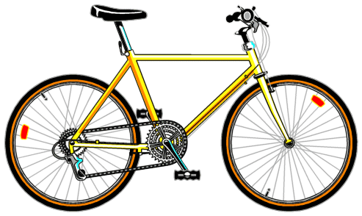
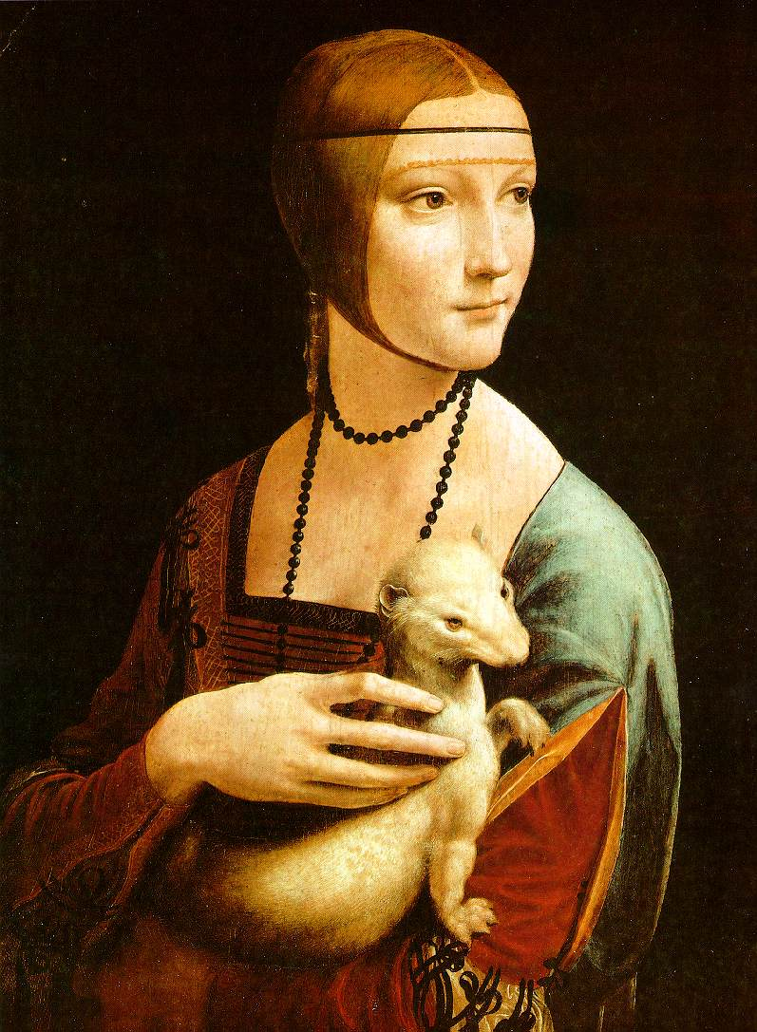
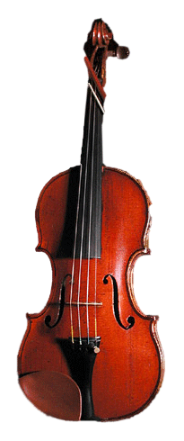
Bag of Words Model in Spatial Pyramid
Extract features
Learn “visual vocabulary” using clustering method
Quantize features using visual vocabulary
Represent images by frequencies of “visual words”

Slide 11
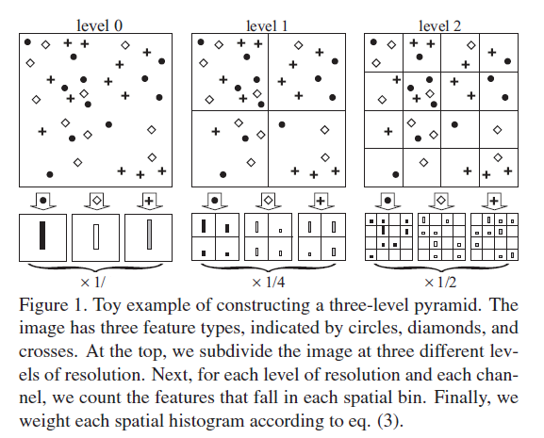
Bag of Words Model in Spatial Pyramid
8

Slide 12
System Outline
Image Set Collection
Bag of Words Model in Spatial Pyramid
Multi-Classifier Training Using SVM
Multi-Classifier Classifier Prediction Using SVM

Slide 13
Multi-Classifier Training Using SVM
One-versus-rest Method
训练时，依次把某个类别的训练样本归为一类,其他所有类别的训练样本归为另一类，这样k个类别的样本就构造出了k个SVM。
Notes:
SVM算法最初是为二值分类问题设计的，当处理多类问题时，就需要构造合适的多类分类器。。

Slide 14
Multi-Classifier Training Using SVM
One-versus-rest Method
训练时，依次把某个类别的训练样本归为一类,其他所有类别的训练样本归为另一类，这样k个类别的样本就构造出了k个SVM。
Notes:
SVM算法最初是为二值分类问题设计的，当处理多类问题时，就需要构造合适的多类分类器。。

Slide 15
Multi-Classifier Training Using SVM
One-versus-rest Method
训练时，依次把某个类别的训练样本归为一类,其他所有类别的训练样本归为另一类，这样k个类别的样本就构造出了k个SVM。
Notes:
SVM算法最初是为二值分类问题设计的，当处理多类问题时，就需要构造合适的多类分类器。。

Slide 16
Multi-Classifier Training Using SVM
One-versus-rest Method
训练时，依次把某个类别的训练样本归为一类,其他所有类别的训练样本归为另一类，这样k个类别的样本就构造出了k个SVM。
Notes:
SVM算法最初是为二值分类问题设计的，当处理多类问题时，就需要构造合适的多类分类器。。

Slide 17
System Outline
Image Set Collection
Bag of Words Model in Spatial Pyramid
Multi-Classifier Training Using SVM
Multi-Classifier Classifier Prediction Using SVM

Slide 18
Multi-Classifier Prediction Using SVM
One-versus-rest Method
分类时，将测试图像的BOW特征输入上面训练好的K个分类器（multi-classifier），每个分类器都会输出一个属于该类别的概率（通常用score来表示），选择概率最大的对应类别作为测试图像的类别。

Slide 19
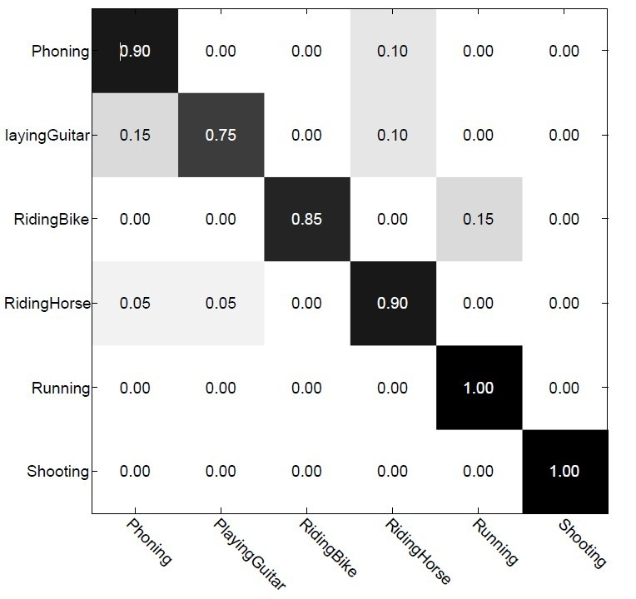
Experience Result

Slide 20
Reference
S. Lazebnik, C. Schmid, and J. Ponce, "Beyond Bags of Features: Spatial Pyramid Matching for Recognizing Natural Scene Categories," CVPR 2006.
Chih-Chung Chang and Chih-Jen Lin, LIBSVM : a library for support vector machines. ACM Transactions on Intelligent Systems and Technology, 2:27:1--27:27, 2011. Software available at http://www.csie.ntu.edu.tw/~cjlin/libsvm
http://blog.csdn.net/v_JULY_v/article/details/7624837
http://blog.163.com/mageng11@126/blog/static/14080837420101120153285/

Slide 21
Thank You!

